Slide 1
Unsupervised Learning
David Quigley
CSCI 4622
2022 Spring

Slide 2


Slide 3
Course Logistics
Problem Set 4: 4/4 @ 11:59PM
Late submissions are still accepted, but Kaggle does not have a good process for this!
If you are looking to submit late, please email and we can go through the process
Late submissions will not be eligible for the “top 25%” Bonus Points
Will be eligible for the >.70 bonus points
Project Milestone 3: Due 4/8
Just a check-in, integrating feedback, etc.

Slide 4
Clustering

Slide 5
Clustering
Clustering – ground truth X
- No ground truth Y*
- Trying to develop classes from the bottom up
- Trying to build based on hidden structure
Finding clusters such that
- Examples within a cluster are similar
- Examples between clusters are dissimilar
*Ground truth may actually exist, we just a) can’t capture it, or b) are choosing to not use it for our task

Slide 6
Clustering – Examples of Similarity
Euclidian Distance = ||x – y ||²
Edit Distance: Number of character changes (insert, delete, edit) to convert string x to string y

Slide 7
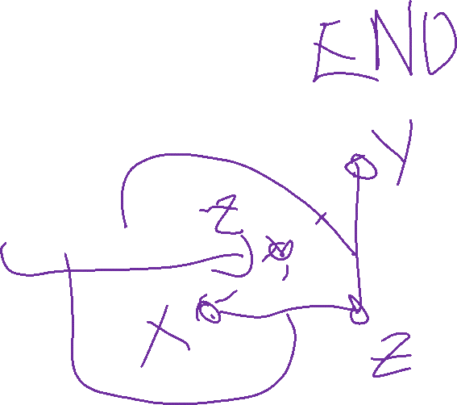
Clustering – Similarity Rules
Given a distance measure d(x,y)
Symmetry: d(x,y) = d(y,x)
Self Consistency: d(x,x) = 0
Positivity: d(x,y) = 0 if x = y
Triangle Inequality: d(x,y) <= d(x,z) + d(z,y)

Slide 8
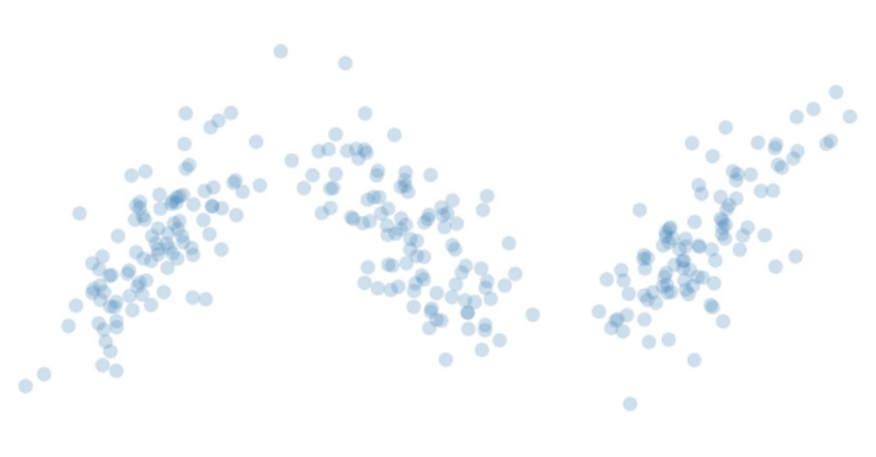
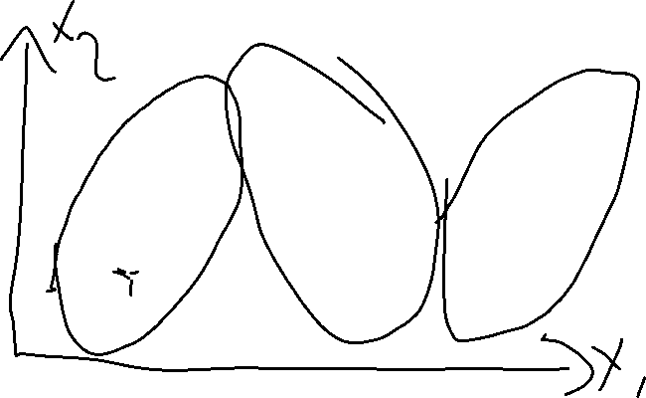
Clustering – K Means
Start with your Data

Slide 9
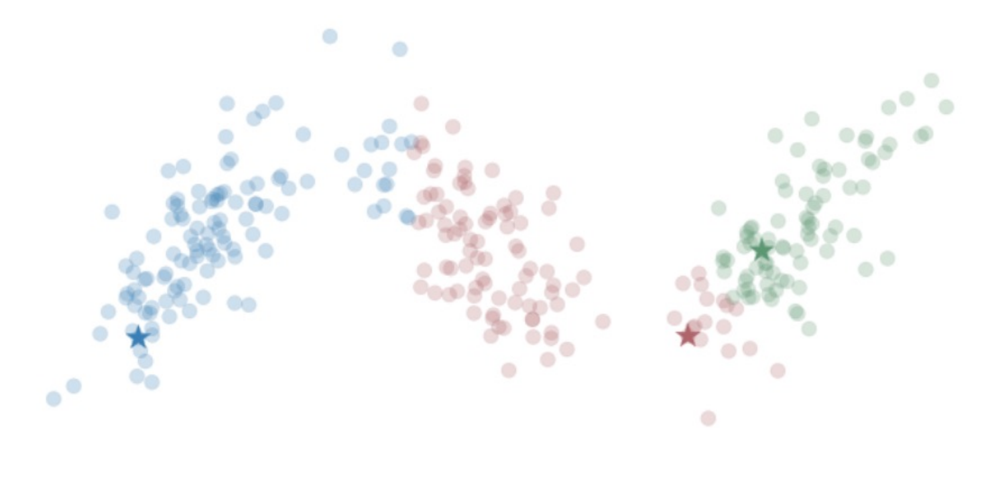
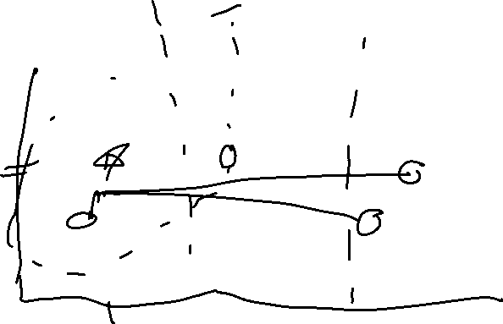
Clustering – K Means
Start with your Data
Choose K centroids
(means)
Assign each point to its
nearest cluster

Slide 10
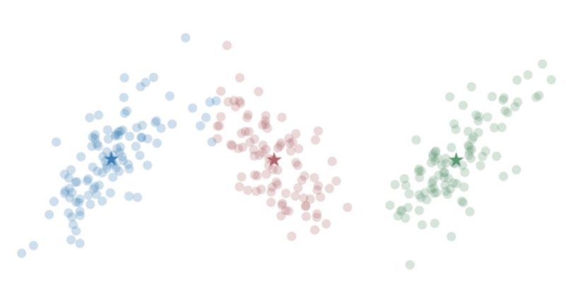
Clustering – K Means
Start with your Data
Choose K centroids
(means)
Assign each point to its
nearest cluster
Re-center your centroids
(means)

Slide 11

Clustering – K Means
Start with your Data
Choose K centroids
Until we converge:
Reassign points
Re-center

Slide 12
Clustering – K Means
Samples = matrix (of features X entries)
Cents = array of K random points (within min, max of each dimension)
While not max_iter, changed_points > 0, Cents – Old_cents > lamda:
Sample_cluster = array tracking nearest centroid (aka cluster)
Cents ← recompute based on Sample_cluster (keep old to loop)
Return sample_cluster, Cents

Slide 13
K Means
What’s going to happen in a variety of edge cases?

Slide 14
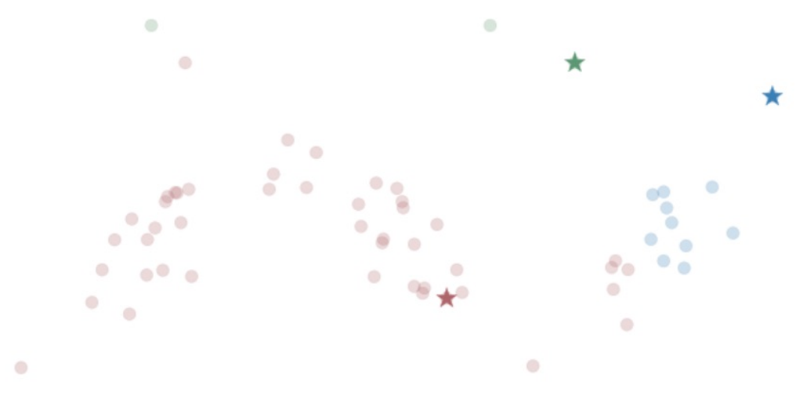
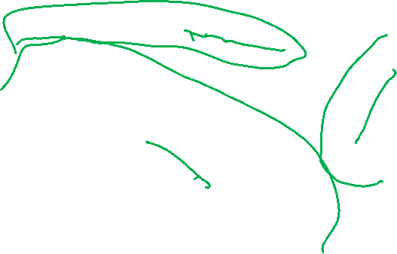
K Means - Outliers

Slide 15
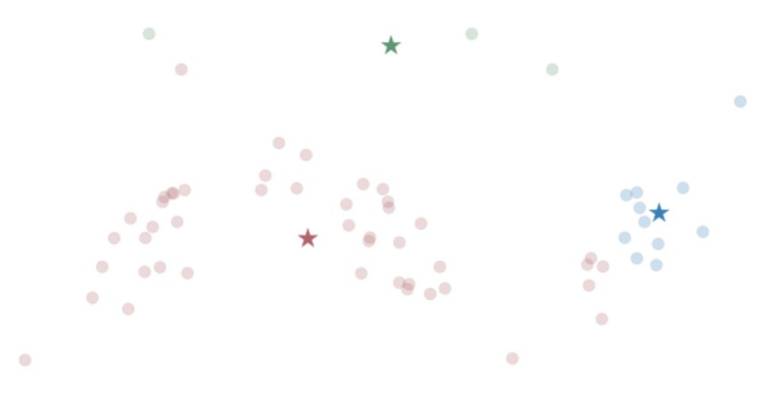
K Means – Outliers

Slide 16
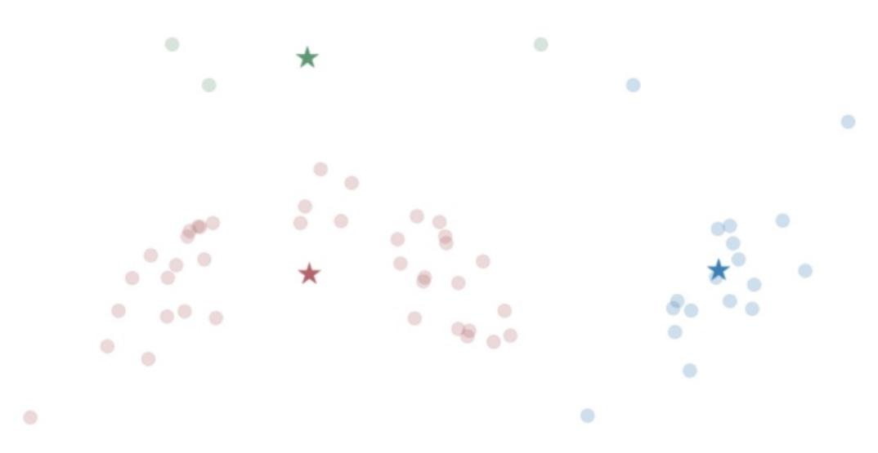
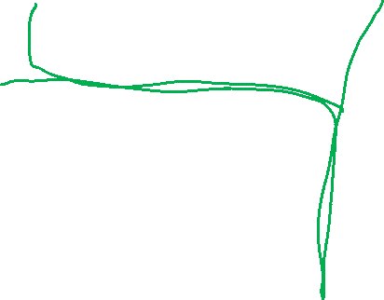
K Means – Outliers

Slide 17
K Means – Sensitive to Initial Centroids
K Means can be easily thrown off by outliers or nonlinearities
Can converge to a variety of points
- Converging to Local Minimum
Fix?

Slide 18
K Means – Sensitive to Initial Centroids
K Means can be easily thrown off by outliers or nonlinearities
Can converge to a variety of points
- Converging to Local Minimum
Fix?
Run several times (random initialization) and choose best

Slide 19
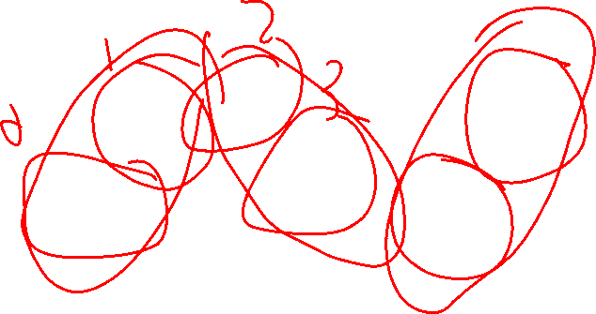
K Means - # Clusters

Slide 20
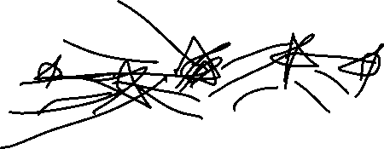
K Means - # Clusters
Choose a theoretically grounded value
- based on the “secret” ground-truth classification
- based on a hypothesis from other research
- based on prior work

Slide 21
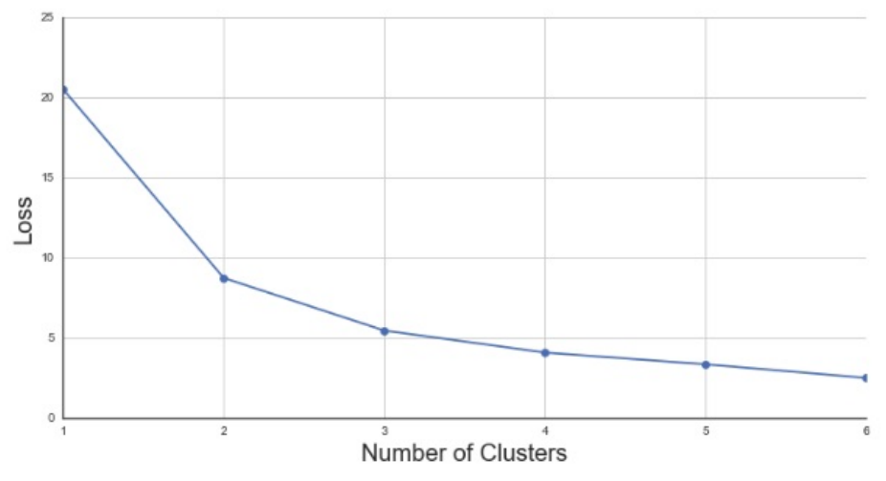
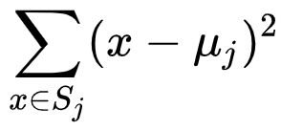
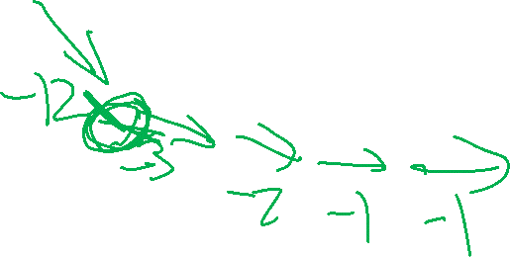
K Means - # Clusters
Elbow Method
- Choose the number of clusters with the most change in the derivative of the loss (i.e. choose the most bent elbow)
L2 Cost Function
Notes:
https://en.wikipedia.org/wiki/K-means_clustering

Slide 22
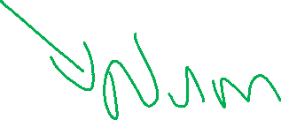
K Means – Categorical Data
Will this approach work?

Slide 23
K Means – Categorical Data
Solution: Encode same or different / create one-hot vectors

Slide 24
K Means – Categorical Data
Solution: Encode same or different / create one-hot vectors
Improvement: adjust distance based on how common an option is
- If 90% of your sample is non-smoking, being a smoking sample is more of an oddity, so perhaps it should differentiate a cluster

Slide 25

K Means – Categorical Data
Solution: Encode same or different / create one-hot vectors
Improvement: adjust distance based on how common an option is
- If 90% of your sample is non-smoking, being a smoking sample is more of an oddity, so perhaps it should differentiate a cluster
- K Means – adjust based on popularity for non-binary
- K Modes – simplify as binary, either most popular choice or not
https://shapeofdata.wordpress.com/2014/03/04/k-modes/

Slide 26
Friday

Slide 27
Course Logistics
Problem Set 4: 4/4 @ 11:59PM
Make sure your code is visible
If you run it on Kaggle we can see it, or share your Jupyter Notebooks or similar
Late submissions are still accepted, but Kaggle does not have a good process for this!
If you are looking to submit late, please email and we can go through the process
Project Milestone 3: Due 4/8
Just a check-in, integrating feedback, etc.
Individual Activity – includes confidential peer feedback!

Slide 28
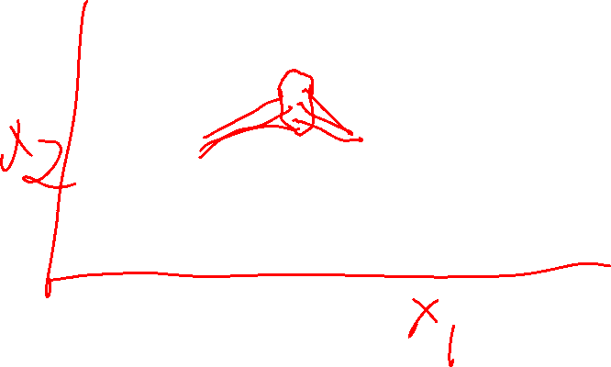
Clustering – K Means
Start with your Data
Choose K centroids
Until we converge:
Reassign points
Re-center

Slide 29
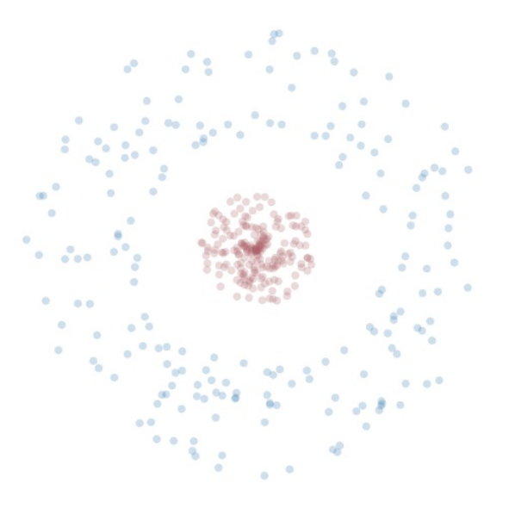
K Means – Non-Convex Clusters

Slide 30
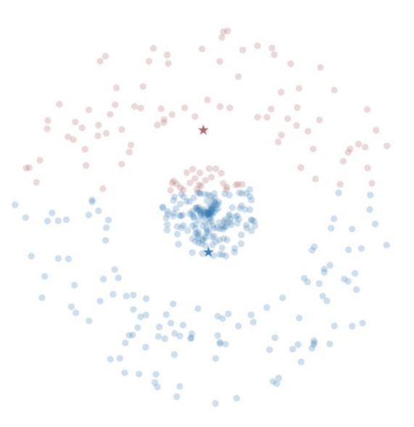
K Means – Non-Convex Clusters

Slide 31
K Means – Convex Clusters Solutions
Transform your data?

Slide 32
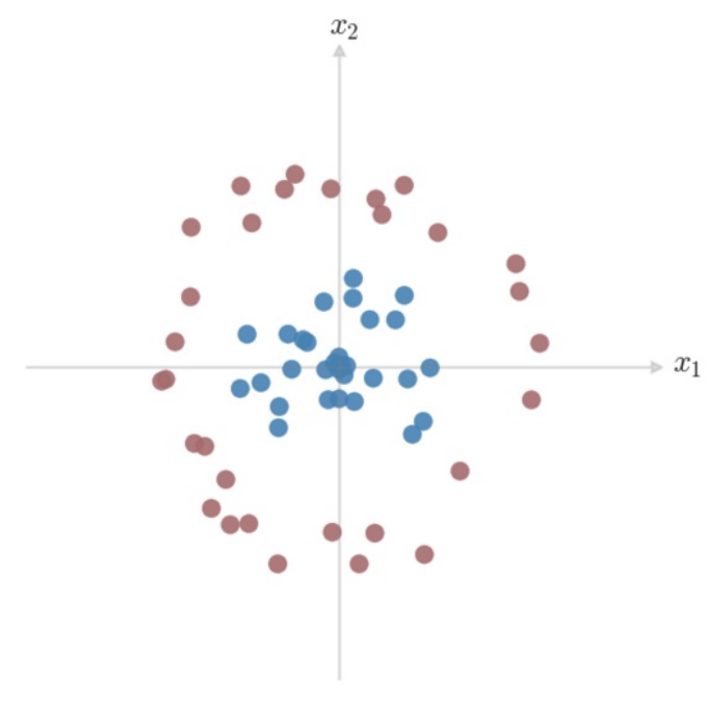
Dimension Projection
How would we separate these classes?
What kind of boundary can we give
this space?
Can we express that boundary in
terms of our given features?

Slide 33
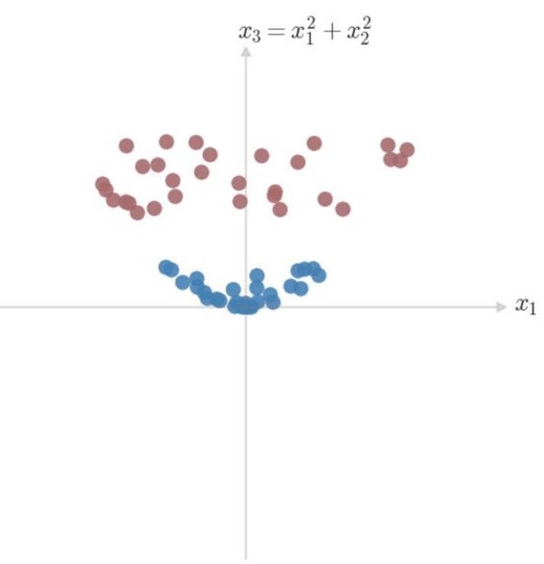
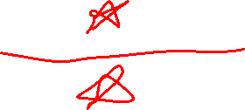
Dimension Projection
How would we separate these classes?
What kind of boundary can we give
this space?
Can we express that boundary in
terms of our given features?

Slide 34
K Means – Convex Clusters Solutions
Transform your data, add iterative testing?

Slide 35
K Means – Pros & Cons
PROS
Simple to understand & implement
Very fast to converge
Can make theoretical sense when mapping to cluster features

Slide 36
K Means – Pros & Cons
PROS
Simple to understand & implement
Very fast to converge
Can make theoretical sense when mapping to cluster features
CONS
Doesn’t handle non-convex clusters well
Sensitive to oddities from outliers, initialization
Makes a hard choice (assigns to one and only one cluster)

Slide 37
Generalizing K Means
Is there a way we can discuss clusters without a hard decision boundary?

Slide 38
Generalizing K Means
Is there a way we can discuss clusters without a hard decision boundary?
Add a probability to the assignment!

Slide 39
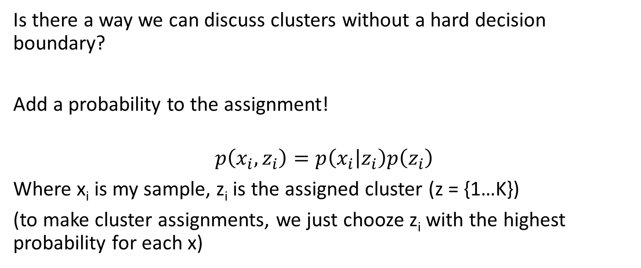
Generalizing K Means
Is there a way we can discuss clusters without a hard decision boundary?
Add a probability to the assignment!
$$p\left(x_{i},z_{i}\right)=p\left(x_{i} | z_{i}\right)p\left(z_{i}\right)$$
Where x_{i} is my sample, z_{i} is the assigned cluster (z = {1…K})
(to make cluster assignments, we just chooze z_{i} with the highest probability for each x)

Slide 40
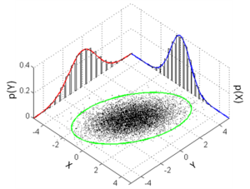
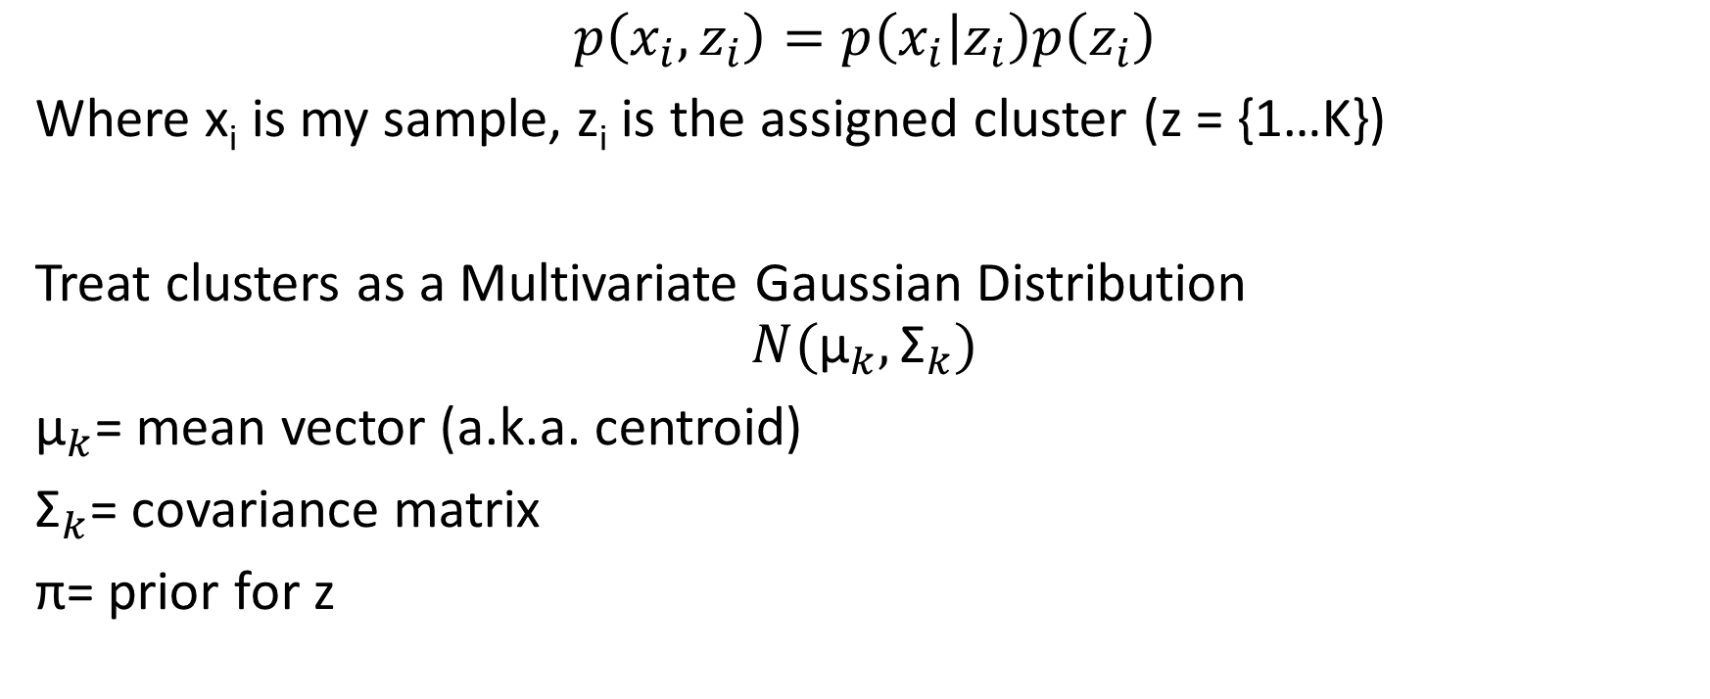
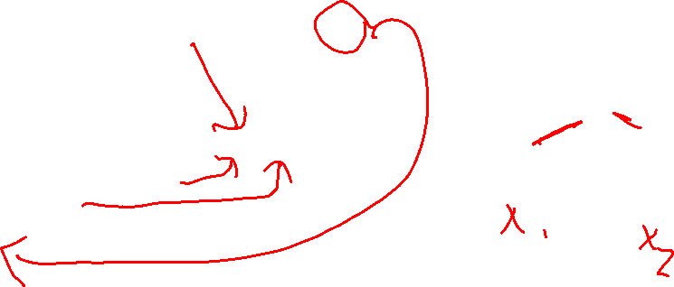
Generalizing K Means – Gaussian Distribution
$$p\left(x_{i},z_{i}\right)=p\left(x_{i} | z_{i}\right)p\left(z_{i}\right)$$
Where x_{i} is my sample, z_{i} is the assigned cluster (z = {1…K})
Treat clusters as a Multivariate Gaussian Distribution
$$N({\text{μ}}_{k},{\text{Σ}}_{k})$$
${\text{μ}}_{k}$= mean vector (a.k.a. centroid)
${\text{Σ}}_{k}$= covariance matrix
$\text{π}$= prior for z
Notes:
https://en.wikipedia.org/wiki/Multivariate_normal_distribution

Slide 41
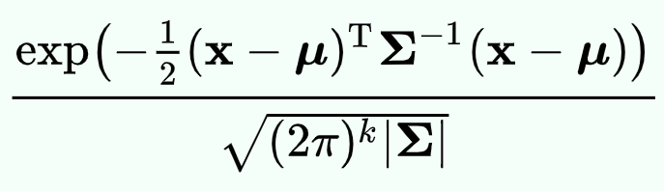
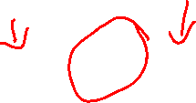
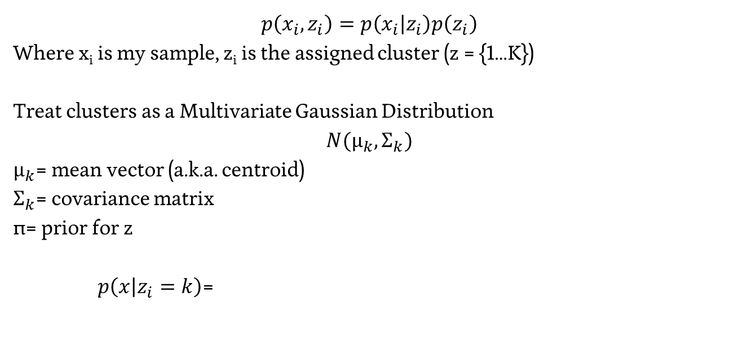
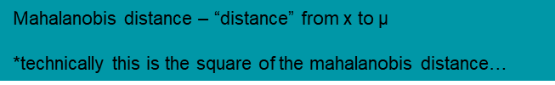
Generalizing K Means – Gaussian Distribution
$$p\left(x_{i},z_{i}\right)=p\left(x_{i} | z_{i}\right)p\left(z_{i}\right)$$
Where x_{i} is my sample, z_{i} is the assigned cluster (z = {1…K})
Treat clusters as a Multivariate Gaussian Distribution
$$N({\text{μ}}_{k},{\text{Σ}}_{k})$$
${\text{μ}}_{k}$= mean vector (a.k.a. centroid)
${\text{Σ}}_{k}$= covariance matrix
$\text{π}$= prior for z
$p\left(x | z_{i}=k\right)$=
Mahalanobis distance – “distance” from x to $\text{μ}$
*technically this is the square of the mahalanobis distance…
Notes:
https://en.wikipedia.org/wiki/Multivariate_normal_distribution

Slide 42
Gaussian Distribution – Gaussian Mixture Model
We can define the probability a set of points x is sampled from a multivariate gaussian…

Slide 43
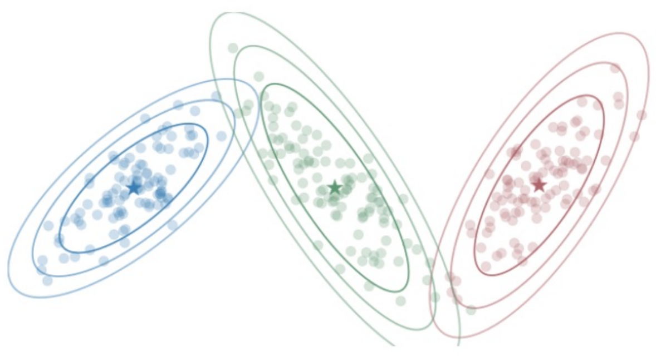
Gaussian Distribution – Gaussian Mixture Model
We can define the probability a set of points x is sampled from a multivariate gaussian…
Let’s try to find a set (mixture) of gaussians that best model the data!

Slide 44
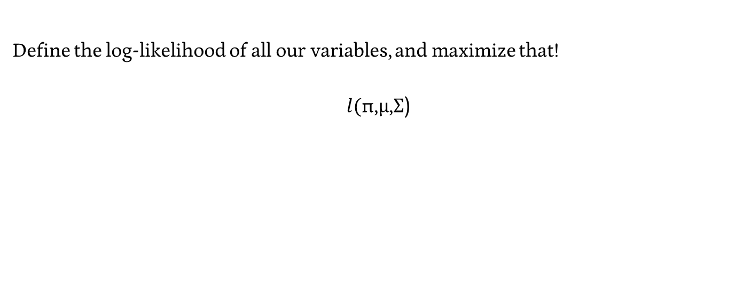
Gaussian Mixture Model – Maximum Likelihood
Define the log-likelihood of all our variables, and maximize that!
$$l(\text{π}\text{,}\text{μ}\text{,}\text{Σ}\text{)}$$

Slide 45
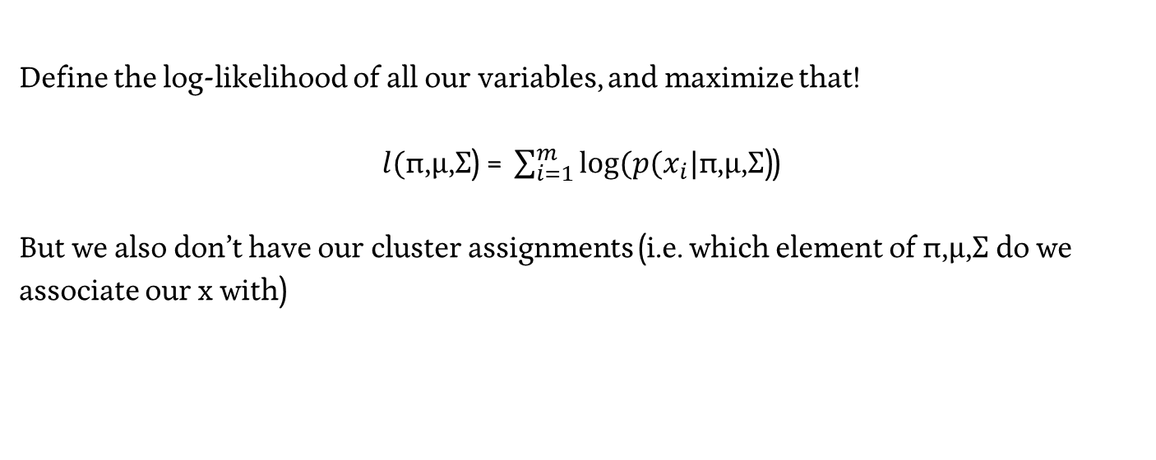
Gaussian Mixture Model – Maximum Likelihood
Define the log-likelihood of all our variables, and maximize that!
$l(\text{π}\text{,}\text{μ}\text{,}\text{Σ}\text{) = }\sum_{i=1}^{m}{log⁡(p(x_{i}|\text{π}\text{,}\text{μ}\text{,}\text{Σ}\text{)}}$)
But we also don’t have our cluster assignments (i.e. which element of $\text{π}\text{,}\text{μ}\text{,}\text{Σ}$ do we associate our x with)

Slide 46
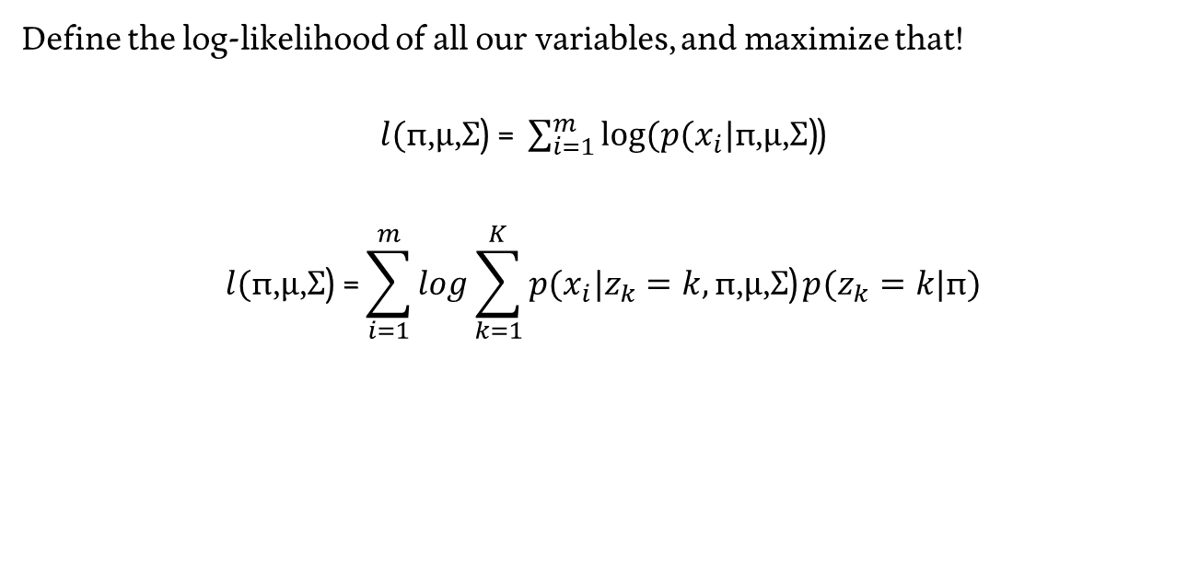
Gaussian Mixture Model – Maximum Likelihood
Define the log-likelihood of all our variables, and maximize that!
$l(\text{π}\text{,}\text{μ}\text{,}\text{Σ}\text{) = }\sum_{i=1}^{m}{log⁡(p(x_{i}|\text{π}\text{,}\text{μ}\text{,}\text{Σ}\text{)}}$)
$$l(\text{π}\text{,}\text{μ}\text{,}\text{Σ}\text{) =}\sum_{i=1}^{m}{log}\sum_{k=1}^{K}{p(x_{i}|z_{k}=k,\text{π}\text{,}\text{μ}\text{,}\text{Σ}\text{)}}p(z_{k}=k|\text{π})$$

Slide 47
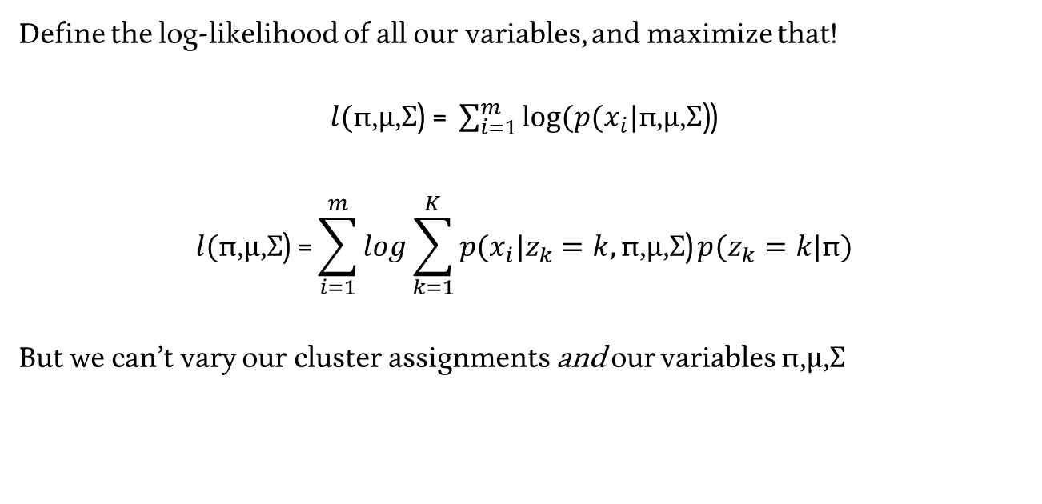
Gaussian Mixture Model – Maximum Likelihood
Define the log-likelihood of all our variables, and maximize that!
$l(\text{π}\text{,}\text{μ}\text{,}\text{Σ}\text{) = }\sum_{i=1}^{m}{log⁡(p(x_{i}|\text{π}\text{,}\text{μ}\text{,}\text{Σ}\text{)}}$)
$$l(\text{π}\text{,}\text{μ}\text{,}\text{Σ}\text{) =}\sum_{i=1}^{m}{log}\sum_{k=1}^{K}{p(x_{i}|z_{k}=k,\text{π}\text{,}\text{μ}\text{,}\text{Σ}\text{)}}p(z_{k}=k|\text{π})$$
But we can’t vary our cluster assignments and our variables $\text{π}\text{,}\text{μ}\text{,}\text{Σ}$

Slide 48
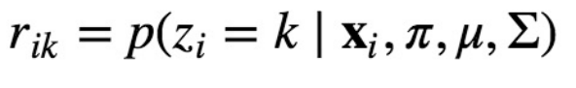
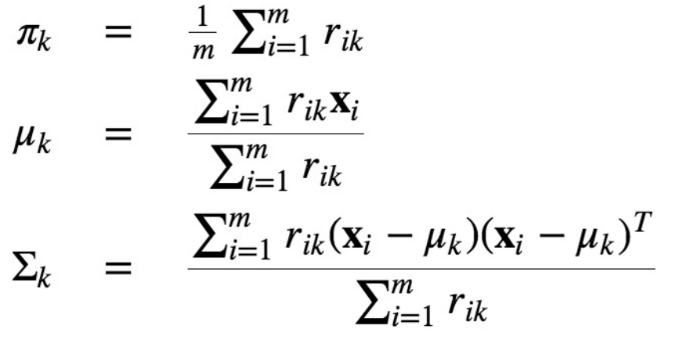
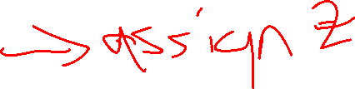
Gaussian Mixture Model – Expectation Maximization
Hold Z fixed, maximize our variables

Slide 49
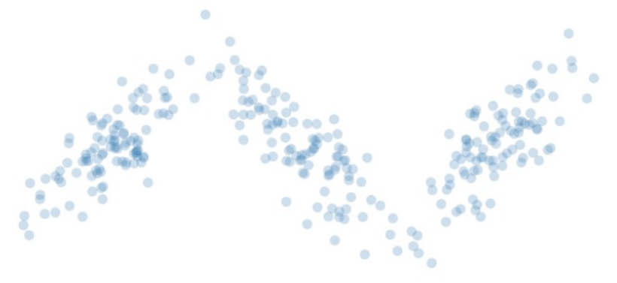
GMM – EM in practice

Slide 50
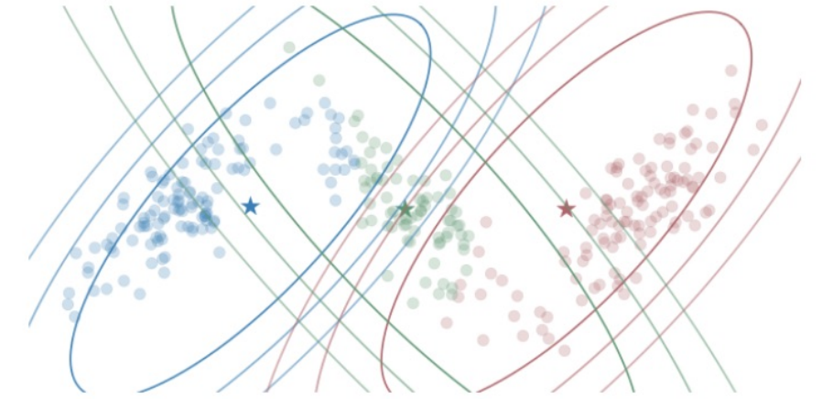
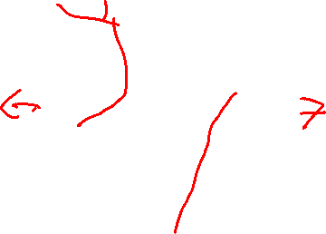
GMM – EM in practice

Slide 51
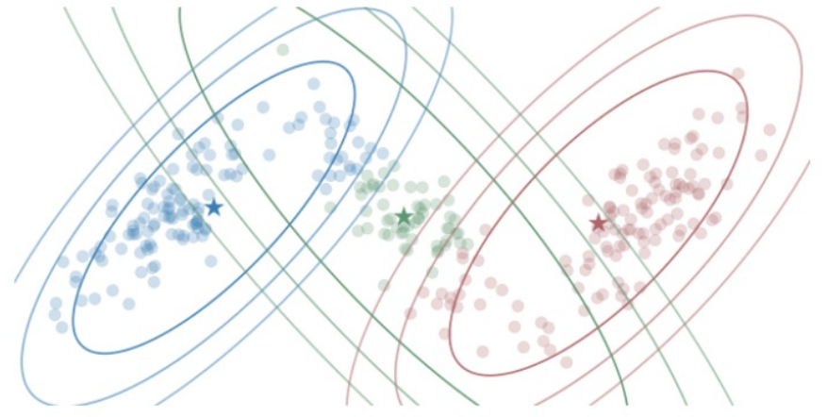

GMM – EM in practice

Slide 52
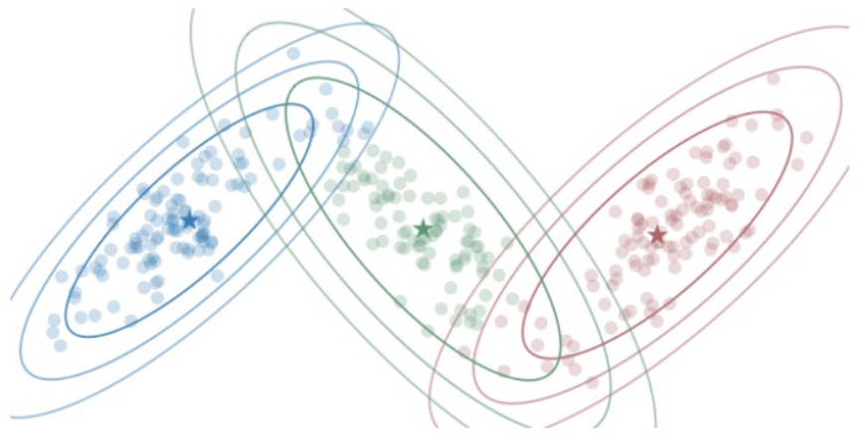

GMM – EM in practice

Slide 53
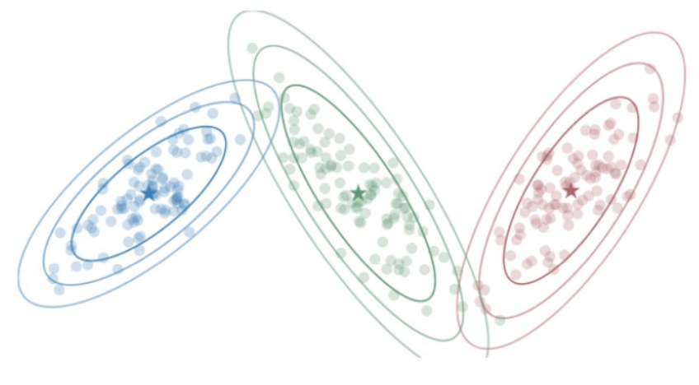

GMM – EM in practice

Slide 54
Principal Components / Singular Value Decomposition

Slide 55
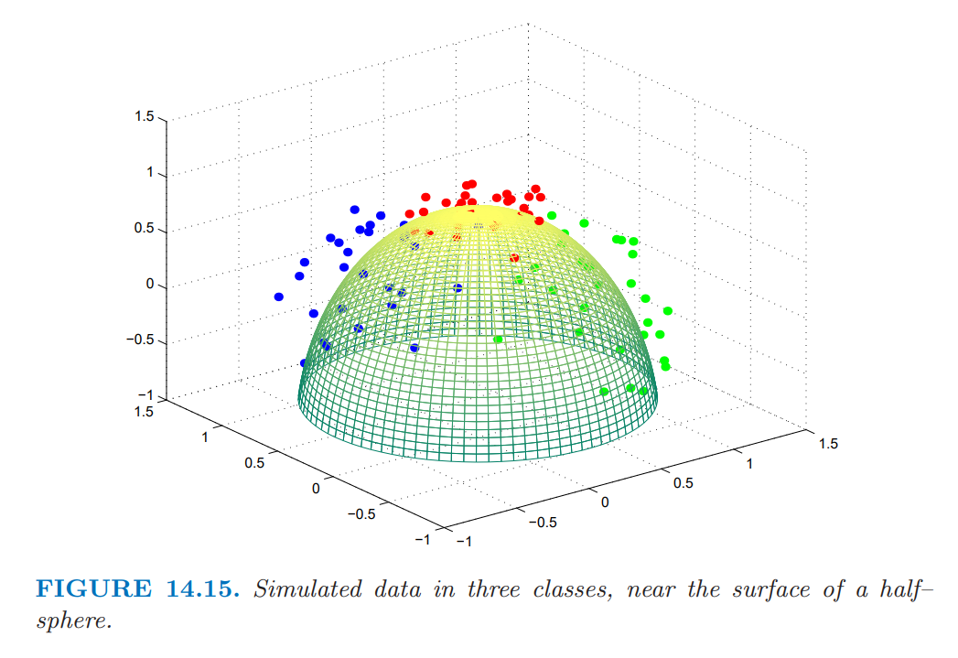
Classification of these data?
Can we predict?
Can we assign?
Can we identify?

Slide 56
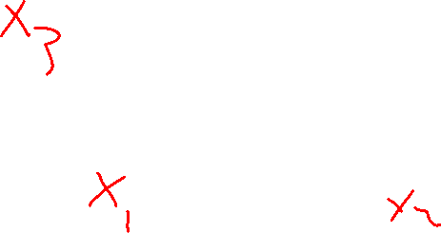
Principal Components – A different objective
What is unique?
What makes an X?

Slide 57
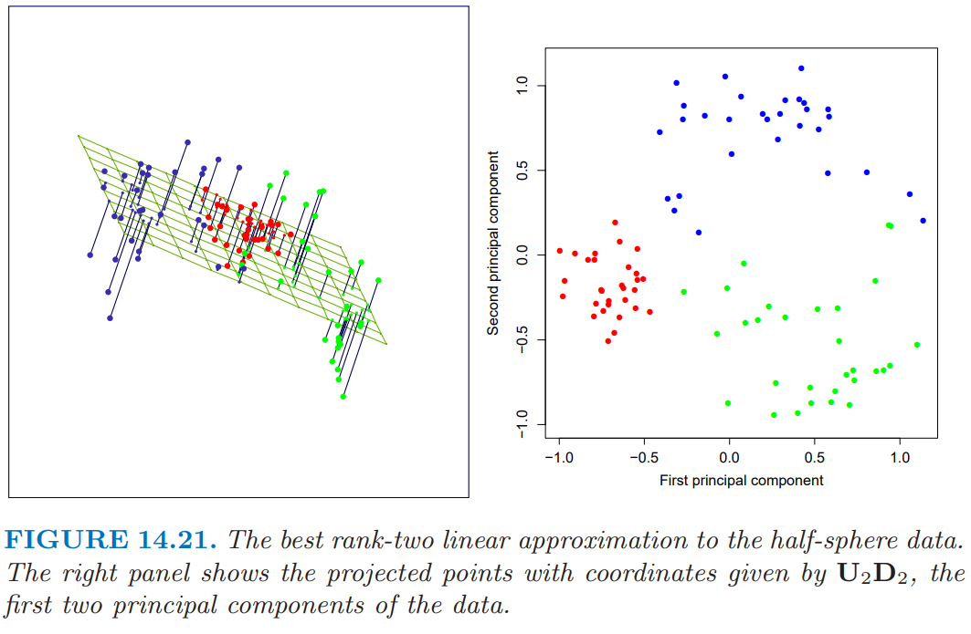
Step 1 – Build a Linear Model Approximation
Implementation details are outlined in ESL Textbook

Slide 58
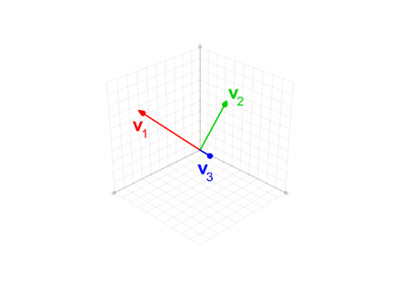
Recall : Gram-Schmidt Process

Slide 59
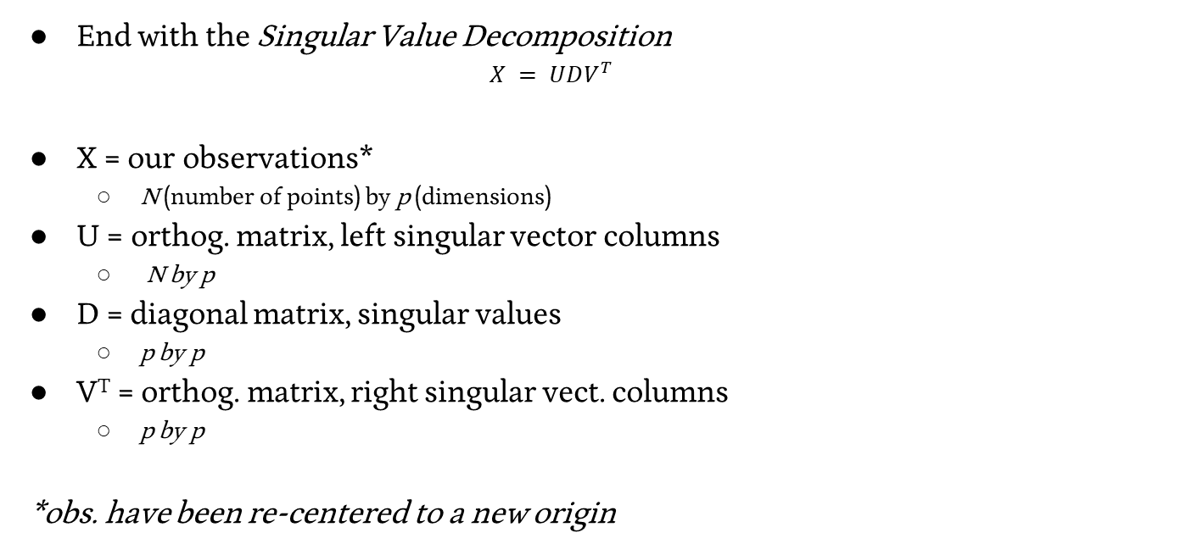
Step 1 – Build a Linear Model Approximation
End with the Singular Value Decomposition
$$X = UDV^{T}$$
X = our observations*
N (number of points) by p (dimensions)
U = orthog. matrix, left singular vector columns
N by p
D = diagonal matrix, singular values
p by p
V^{T} = orthog. matrix, right singular vect. columns
p by p
*obs. have been re-centered to a new origin

Slide 60


Step 2 – Extract the q principal components you seek
$X_{q} = U_{q}D_{q}$

Slide 61


PCA In Action

Slide 62

Was this the best fit?

Slide 63

Principal Surface Analysis
End objective – a smoothed curve that best approximates our data

Slide 64

Step 1 - Build a Linear Model Approximation

Slide 65

Step 2 – Bend it! (like Beckham?)
Iteratively:
Hold $λ$ fixed, enforce self consistency on your curve
$$f_{j}(λ)←E(X_{j} |λ(X)=λ);j=1, 2, . . . , p$$
Hold the curve fixed, minimize your $λ$ (find the closest point on the curve for each data point)
$${\hat{λ}}_{f}(x)←{argmin}_{λ′}||x−\hat{f}(λ′)||2$$

Slide 66

Principal Surface Analysis
End objective – a smoothed curve that best approximates our data

Slide 67


Kernel PCA

